Slide 1

Python for QA
HTTP, JSON, XML, HTML

Slide 2
Requests

Slide 3
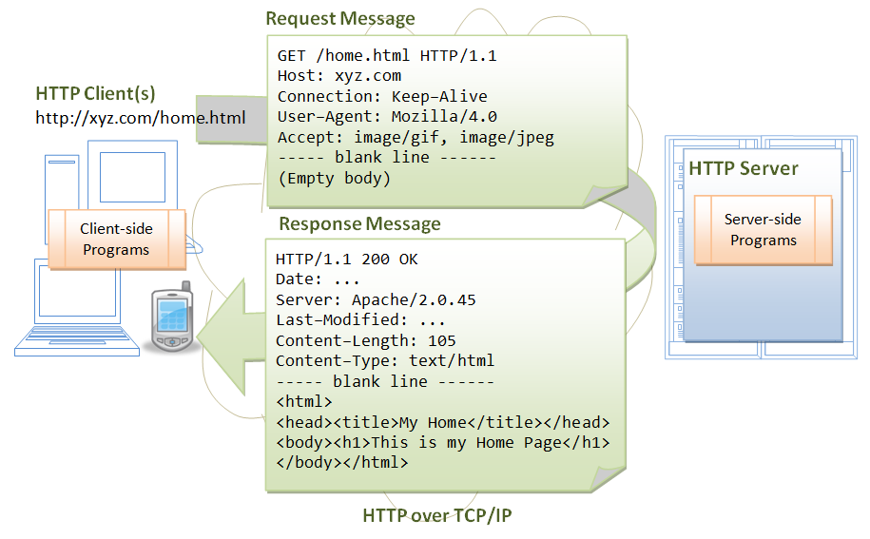
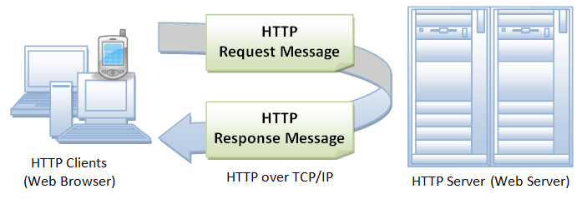
HTTP Introduction
Notes:
https://www.w3.org/Protocols/rfc2616/rfc2616.txt

Slide 4

Requests: HTTP for Humans
Requests is an elegant and simple HTTP library for Python, built for human beings.
Sessions with Cookie Persistence
Basic/Digest Authentication
Automatic Content Decoding
Unicode Response Bodies
Streaming Downloads
Notes:
http://docs.python-requests.org/en/master/

Slide 5
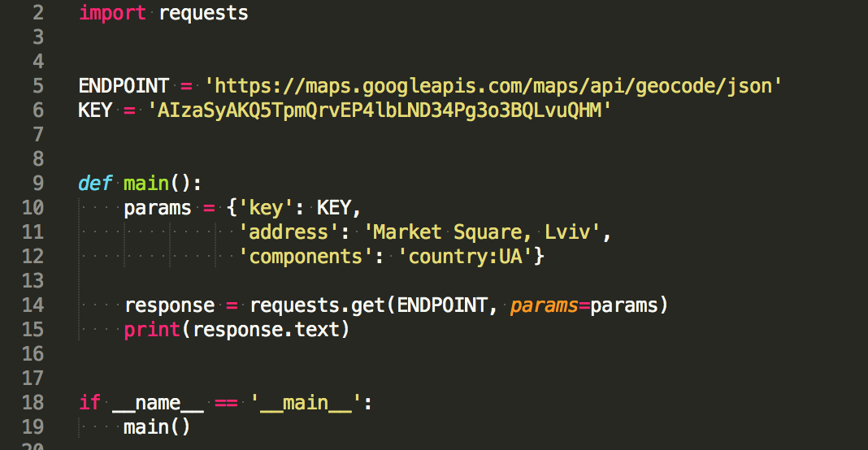
HTTP GET and POST Using Requests
requets
  get
    url
    params
    headers
  post
    url
    data
    headers
Notes:
https://github.com/kennethreitz/requests/blob/master/requests/api.py

Slide 6
Response in Requests
text | decoded content of server’s response
encoding | encoding used to decode response
content | response body as bytes
json() | decoded to JSON response, if invalid or empty - raises exception
status_code | response status code
headers | server’s response headers
cookies | server’s response cookies

Slide 7
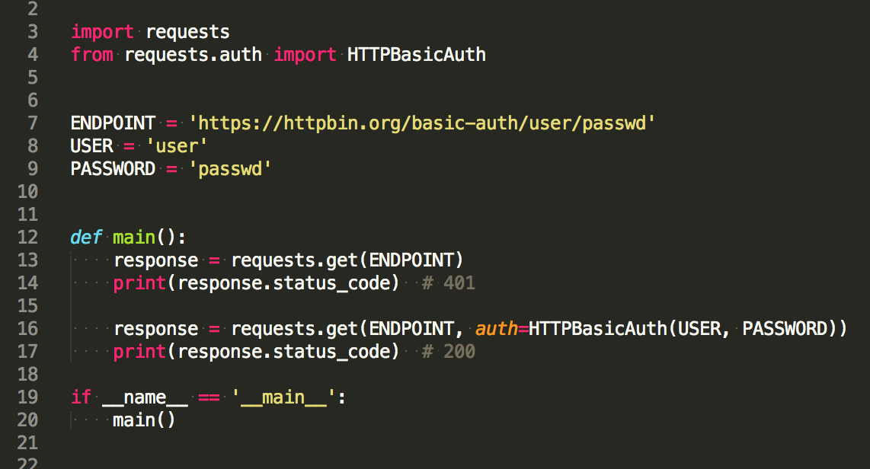
Authentication

Slide 8
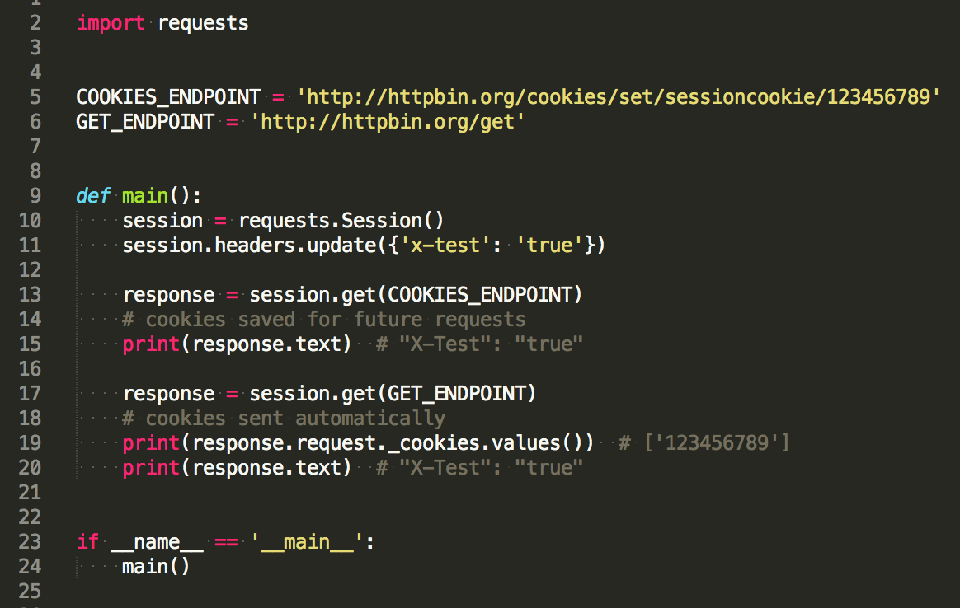
Session Support
persist parameters across requests
persist cookies across requests
reuse TCP connection

Slide 9
Practice
Using requests and service https://httpbin.org/:
Send GET and POST requests
Examine response object
Pass basic authentication
Using session show parameters and cookies scope
Notes:
Example with Facebook API

Slide 10
JSON

Slide 11

Module Json
JSON (JavaScript Object Notation), specified by RFC 7159 and by ECMA-404, is a lightweight data interchange format inspired by JavaScript object literal syntax
json
  dumps()
  loads()

Slide 12
Encoders and Decoders
JSON | Python
object | dict
array | list
string | str
number (int)/(real) | int/float
true/false | True/False
null | None
Python | JSON
dict | object
list, tuple | array
str | string
int, float | number
True/False | true/false
None | null

Slide 13
Practice
Serialize Python dict to JSON
Deserialize JSON to Python objects
Using Google Maps API find latitude and longitude for address

Slide 14
XML

Slide 15
The ElementTree XML API
<course>
<name>Python for QA</name>
<modules>
<module id="module1">
Cource Introduction
<examples>
<example>Install Git</example>
<example>Install PyCharm</example>
</examples>
</module>
<module id="module2">Introduction to Python</module>
<module id="module3">Python Basics</module>
<module id="module4">Python Intermediate</module>
<module id="module5">
HTTP, JSON, XML, HTML
<examples>
<example>Use requests</example>
<example>Parse XML</example>
</examples>
</module>
</modules>
</course>
import xml.etree.ElementTree as etree
course_xml = etree.parse('course.xml')
root = course_xml.getroot()
# Elements are lists
for child in root:
print(child) # <Element 'name' at 0x...>, <Element 'modules' at 0x...>
# Attributes are dicts
modules = root[1]
for module in modules:
print(module.attrib) # {'id': 'module1'}, {'id': 'module2'} …
module4 = modules[4]
print(module4.text.strip()) # HTTP, JSON, XML, HTML
Notes:
http://effbot.org/zone/element.htm
http://www.diveintopython3.net/xml.html
https://docs.python.org/2/library/xml.etree.elementtree.html
add arrows to code, the same approach use with xpath

Slide 16
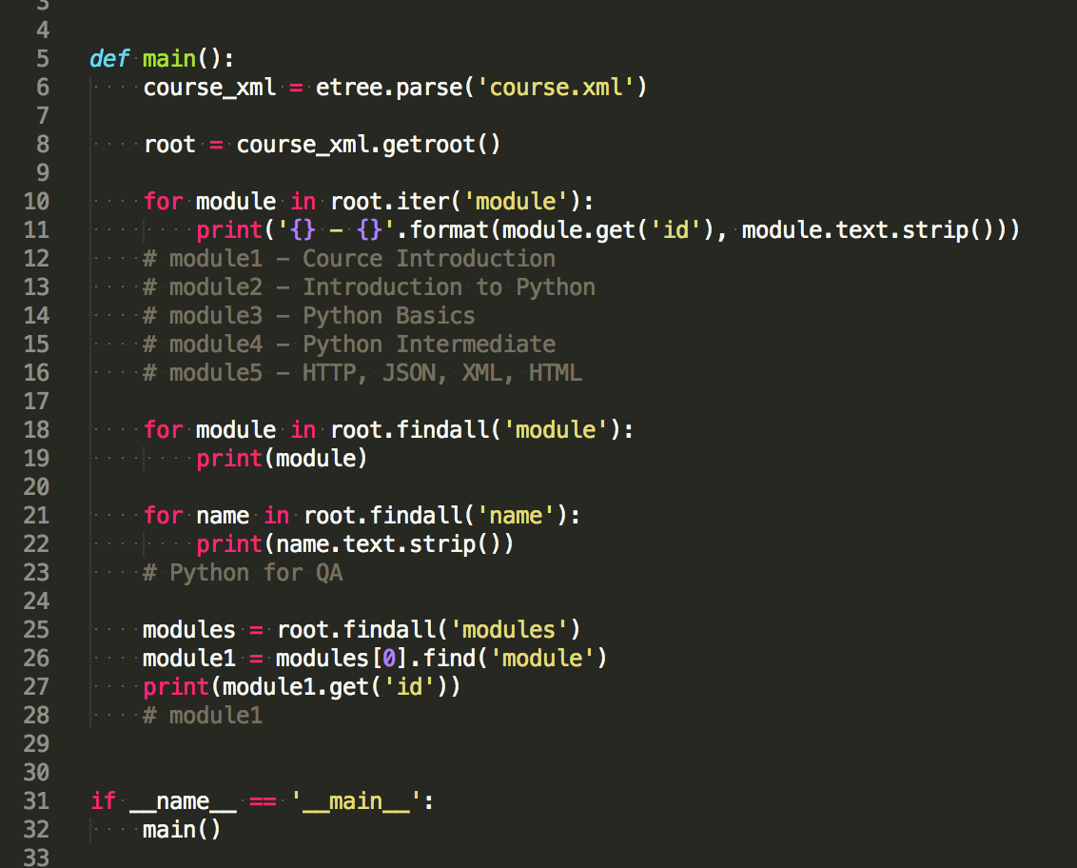
Search in XML
iter()
get()
findall()
find()

Slide 17
XPath
tag | Selects all child elements with the given tag
* | Selects all child elements.
. | Selects the current node
// | Selects all subelements, on all levels beneath the current element
.. | Selects the parent element
[@attrib] | Selects all elements that have the given attribute
[@attrib='value'] | Selects all elements for which the given attribute has the given value
[tag] | Selects all elements that have a child named tag
[tag='text'] | Selects all elements that have a child named tag whose complete text content, including descendants, equals the given text
Notes:
http://www.w3schools.com/xsl/xpath_intro.asp

Slide 18
XPath Examples
root.findall('.//example')
root.findall('./modules/*')
root.findall('.//module[@id="module5"]//example[0]')
root.findall('.//examples/..')
root.findall('.//module[examples]')
root.findall('.//module[@id]')
root.findall('.//module/examples/[example="Parse XML"]')
all examples
all modules
first example for module 5
all modules which have examples
all modules which have examples
all modules that have id attribute
example with text “Parse XML”

Slide 19

Library lxml
lxml is the most feature-rich and easy-to-use library for processing XML and HTML in the Python language.
import xml.etree.ElementTree as etree => from lxml import etree
Standards-compliant XML support
Support for (broken) HTML
Full-featured
Actively maintained by XML experts.
fast. fast! FAST!
Notes:
http://effbot.org/zone/element.htm
http://www.diveintopython3.net/xml.html

Slide 20
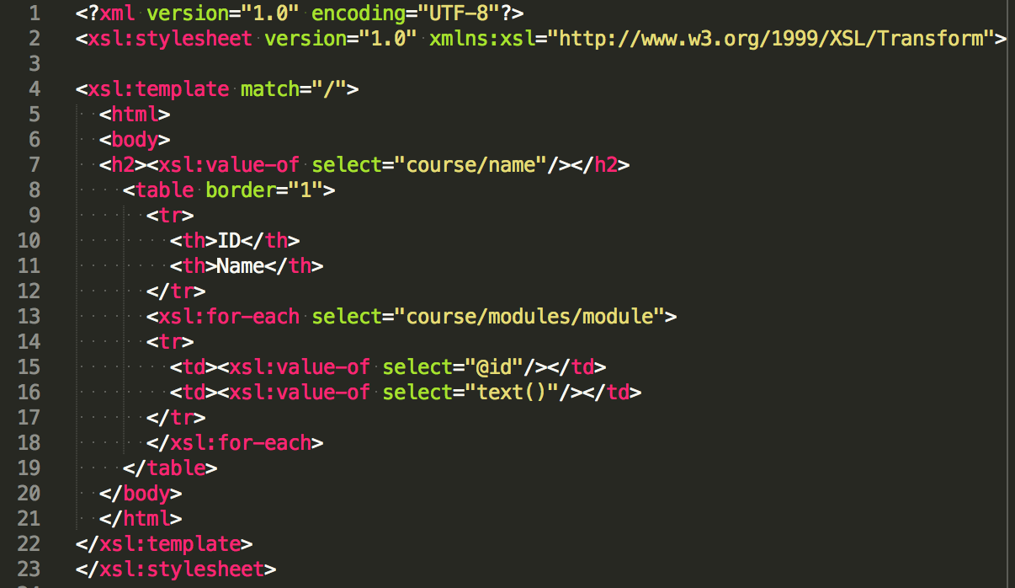
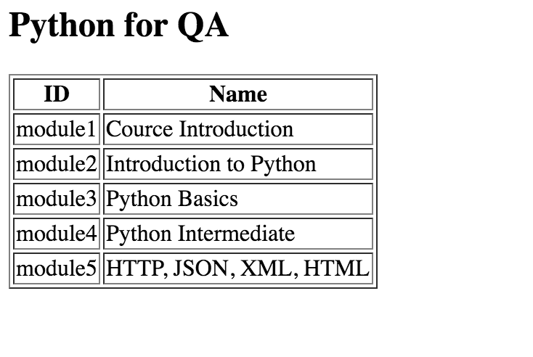
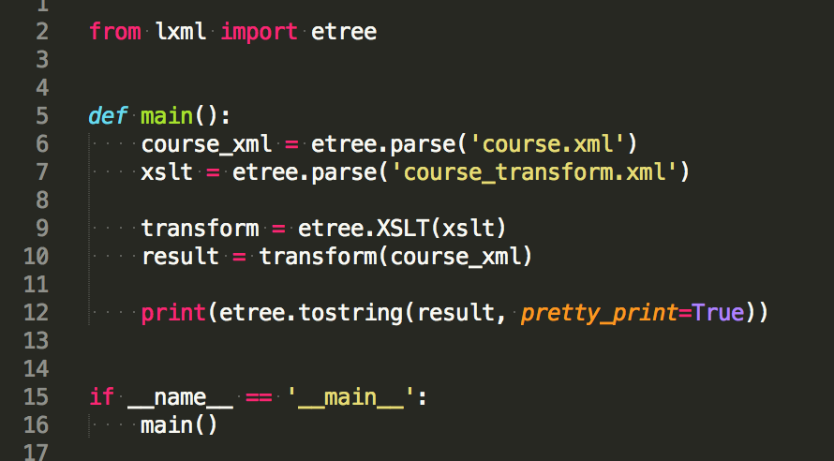
XSLT
XSLT is a language for transforming XML documents into XHTML documents or to other XML documents.
Notes:
http://www.w3schools.com/xsl/xsl_intro.asp
http://www.w3schools.com/xsl/tryxslt.asp?xmlfile=cdcatalog&xsltfile=cdcatalog

Slide 21
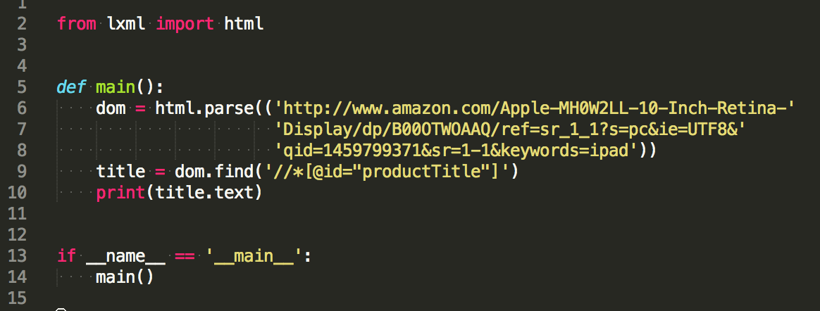
Parsing HTML with lxml
Notes:
http://lxml.de/parsing.html

Slide 22
Practice
XML parsing and iterating through nodes
XPATH examples
Using lxml library
Simple XSLT transformation
Parse from web page

Slide 23
Summary

Slide 24
Keywords
requests
json
ElementTree
lxml

Slide 25
Useful
Requests
Json
The ElementTree XML API
lxml

Slide 26
Home task
Solve nexts tasks.
Level 1 - 1 point
Level 2 - 2 points
Level 3 - 4 points
Please create task*.py file for each problem solution in directory lesson4, where * is task number.

Slide 27
Questions?

